Slide 1
Model-Based Design for Medical Devices
William Banks

Slide 2
Contents
Domain
Motivation
Goal
Model Example
WebGME Approach
Model Implementation

Slide 3
Domain: medical devices
$289 billion market ($110 billion from US alone)
Closed-loop medical devices of specific interest
Interact with patient and make decisisions via their own diagnosis
No direct feedback from patient to device
Example: Pacemaker needs to determine when it paces
Safety is a critical aspect
How accurately it provides information
How precisely it operates as designed

Slide 4
Motivation: existing challenges in design process
Medical Device recalls
Electrical/Mechanical parts wear out and are subject to corrosion, fatigue, etc.
Software failure is sourced in design and development of system
15% of device recall due to software failure
Safety
ISO 14971
Application of risk management
for medical devices
ISO 800002-1
Apply ISO 14971 to medical device software
software guidelines to ensure safety
IEC 62304
Software development life cycle
evoke safety practices

Slide 5
Motivation: benefits of model-based design
Already see benefits of integration within automotive and avionics industries
Works best with well defined systems like automobiles an aircraft
Clinical trials are not scalable
Time consuming
Expensive
Risks found at this junction are expensive to fix
Allows verifying design conditions prior to clinical trials
Remove the ‘safety gap’
Cheaper to implement fixes

Slide 6
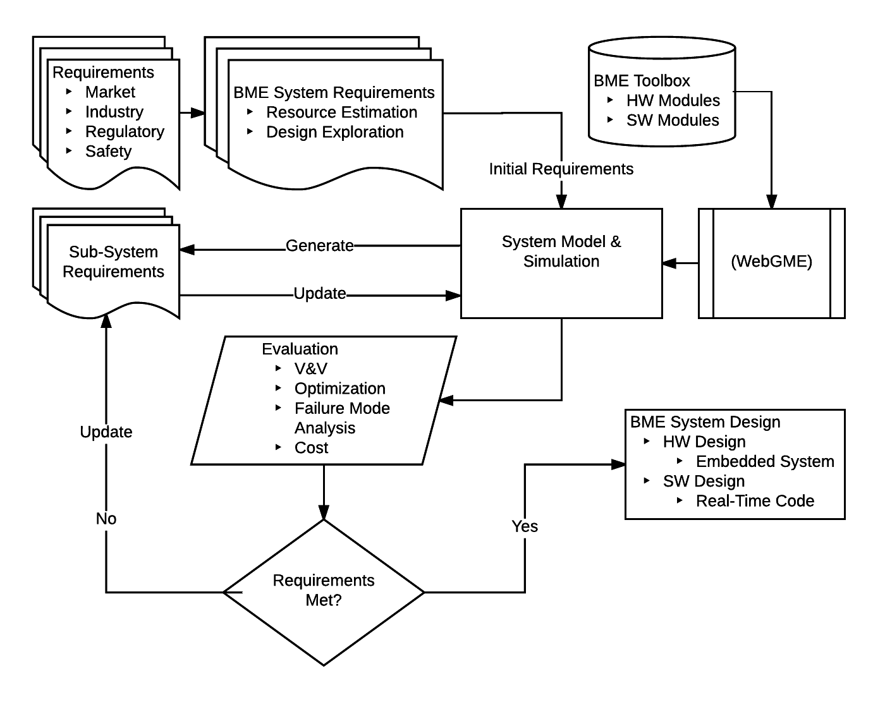
Goal: BME design flow

Slide 7
Goal: initial objectives
Assess current DSMLs for BME applications
Develop DSML for BME applications that incorporates regulatory and industry requirements as attributes of components.
Focus on design space and constraint modeling, safety, risk analysis
Identify attributes and attribute values unique to BME
Develop a library of components
Use components to design application (closed feedback system: insulin pump, data recorder-to-MD, venous pressure monitor, etc.)
Show that modeling can be used to refine the design through recursive requirement updates: Sys. Reqs→Model→V&V→ Sub-Sys. Reqs.→ Model→ V&V→. . . . →Design
Self-documentation of performance progression, safety and regulatory pathway
Establish method to expand component library

Slide 8
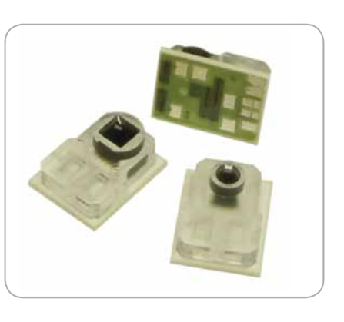
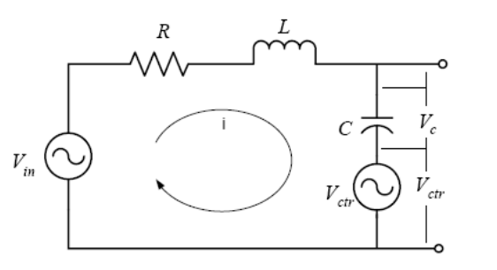
Model Example: blood pressure measurements
Modelica
LT-Spice
Sensor Interface
Hydraulics
Pressure Transducer
NPC-100/120
Sensor
Bridge circuit
Sensitivity
datasheet
Physiological Model
RCL abstraction
Sensor Readout
Electronics

Slide 9





Model Example: venous system sensor interface abstraction
$A0sin⁡(ω$t)
$$r1$$
$$P\left(t\right)1$$
$$r2$$
$$P(t)2$$
Objective: model simple fluid system in Modelica to represent a catheter transducer system to measure blood pressure
A piston pump connected to a tank via 2 pipes of different diameters
A latch on the top pipe opens outward with positive pressure and closes in equilibrium or negative pressure
P(2)₂ is the pressure as measured in a catheter

Slide 10
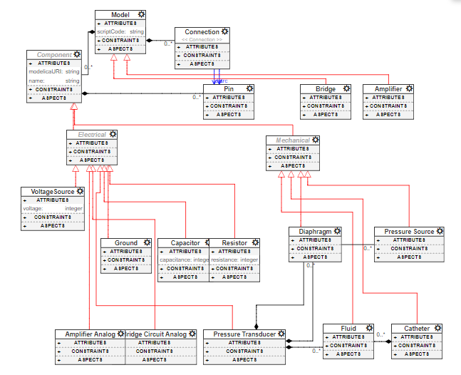
WebGME Approach: initial design
Goal: create a common framework to connect electrical and mechanical compoents
Challenge:
uncooperative Modelica translator plugin
Limitations in incorporating ‘saftety’ checking
Scope too broad
Refine for proof of concept case

Slide 11
WebGME Approach: challenges and new design
Bit off more than could chew
Interfacing electrical and mechanical domains non-trivial
Invoking quantitative safety factors non-trivial
Simplification!
Focus on electrical domain to design abstracted BME systems
Proof of concept

Slide 12
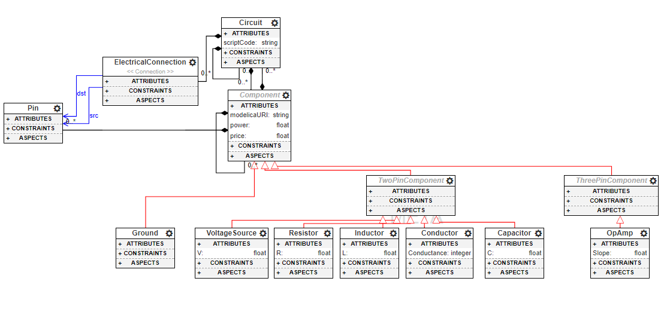
WebGME Approach: new design
Removed mechanical components
Troubleshoot with online WebGME help wiki
Working plugin!
Scope now narrow for effective proof-of-concept case
Focus on implementing catheter-transducer system

Slide 13
Model Example (revisited): catheter-transducer system
Modelica
LT-Spice
Sensor Interface
Hydraulics
Pressure Transducer
NPC-100/120
Sensor
Bridge circuit
Sensitivity
datasheet
Physiological Model
RCL abstraction
Sensor Readout
Electronics

Slide 14
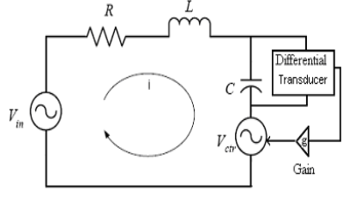
Model Example (revisited): catheter-transducer system (2nd and 4th order)
Voltage (Vin): pressure wave
Resistor (R): fluid resistance
Inductor (L): fluid inertance
Capacitor (C): compliance
Feedback:
Measure voltage drop across capacitor and generate a counter signal

Slide 15
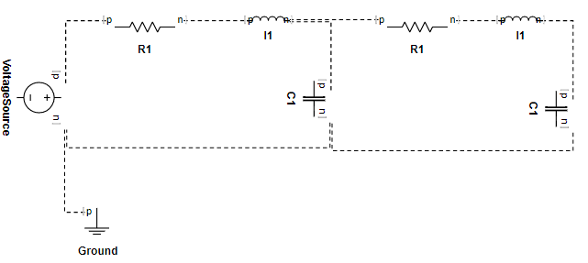
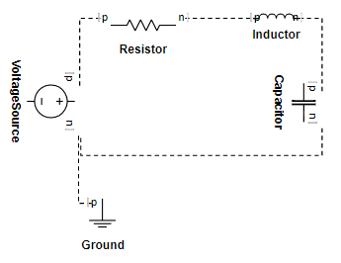
Model Example (revisited): 2nd and 4th order catheter-transducer system

Slide 16
DEMO

Slide 17
Thank You!
Questions?

